Slide 1
Defensive Coding
Carlos.Leigue@Jalasoft.com

Slide 2
Agenda
What is defensive coding?
Improving Comprehension
Improving Predictability
Improving Quality
More on Predictability

Slide 3
Defensive Coding
What is defensive coding?
Approach to improve software and source code, improving:
Comprehension
Quality
Predictability

Slide 4
Defensive Coding
What is defensive coding?
Comprehension
Source code understandable, readable
Simplifies maintenance
Quality
Reduces bugs and problems
Predictability
Consistent code
Software behaves in a predictable manner
Clean Code
Automated Code Testing
Validation and Exception Handling

Slide 5
Defensive Coding
Improving Comprehension
It is easier to implement defenses when we start with clean code.
Refactor methods with
Clear Purpose
Good Name
Focused Code
Short Length
Automated Code Test
Predictable Result

Slide 6
Defensive Coding
Improving Predictability
A method is a contract that promises …
Receive parameters
Return an specific type
Throw defined exceptions
Verify:
Incoming parameters
Data (state, global)
Return type
Throw expected exceptions
external source
DB, files, etc.
user
method(…)
returns
internal source
other code

Slide 7
Defensive Coding
Improving Predictability
Minimize Number of Parameters
Consistent Parameter Ordering
Guard Clauses
Code typically at the top of the method that allows only valid input to proceed.

Slide 8

Defensive Coding
Improving Predictability
No validations

Slide 9
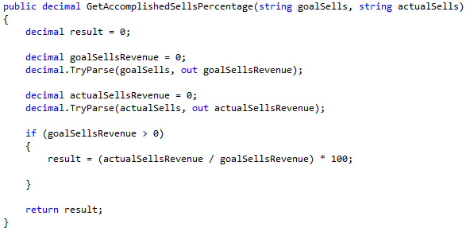
Defensive Coding
Improving Predictability
Validated
“0” returned as result does not help to solve the invalid input problem

Slide 10
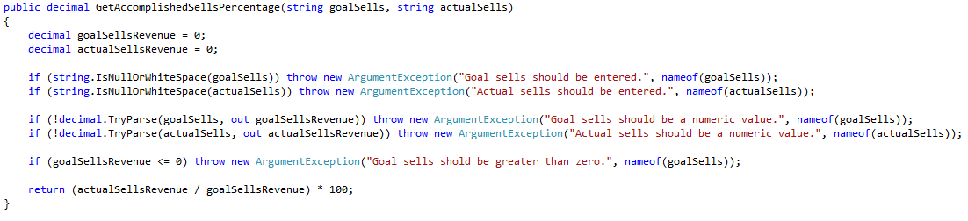
Defensive Coding
Improving Predictability
Fail Fast technique
throwing expected exceptions
method size increased

Slide 11
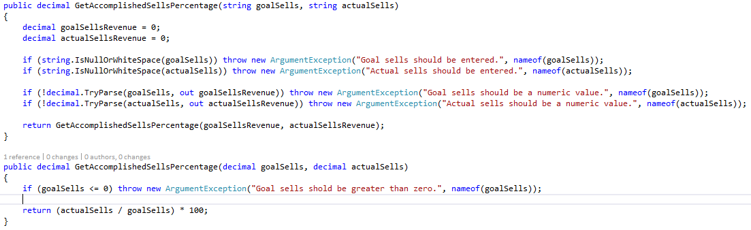
Defensive Coding
Improving Predictability
Method overloading

Slide 12
Defensive Coding
Improving Quality
Automated Code Tests
Structured
Self-documented
Automatic
Repeatable
Arrange
Act
Assert

Slide 13
Defensive Coding
Improving Quality
Automated Code Tests
Save Time
Find Bugs Faster
Refactor/ Add Features Safely
Enhance Your Value
Minimize Interruptions
Tests for
Valid Inputs
Invalid Inputs
Guard Clause
Assumptions
Bug Fixes

Slide 14
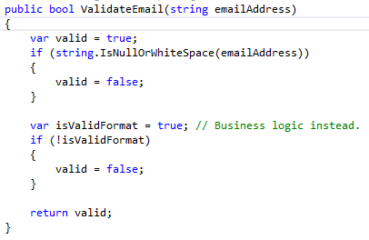
Defensive Coding
More on predictability
The result of a method could be …
Value
Exception
Multiple Values
Null
Result as Value
Useful with calculations

Slide 15
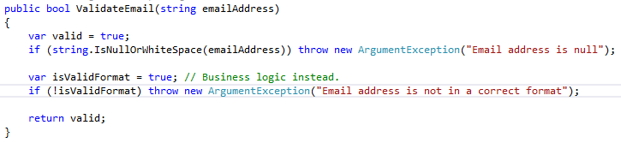
Defensive Coding
More on predictability
Result as Exception
Validating incoming parameters
Exceptional conditions occur

Slide 16
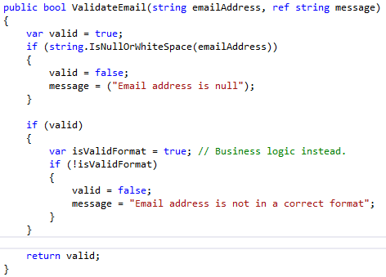
Defensive Coding
More on predictability
Result as
Multiple Values
ref

Slide 17
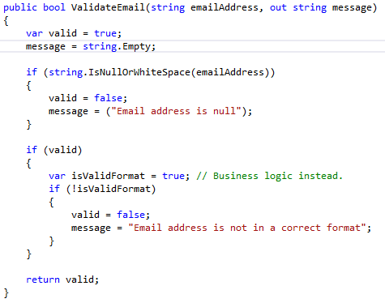
Defensive Coding
More on predictability
Result as
Multiple Values
out

Slide 18
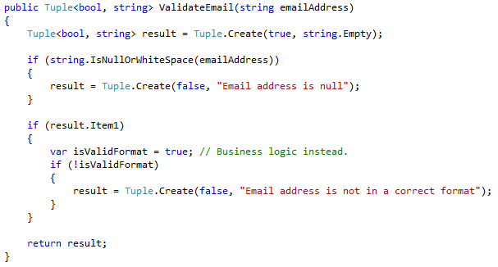
Defensive Coding
More on predictability
Result as
Multiple Values
tuple

Slide 19
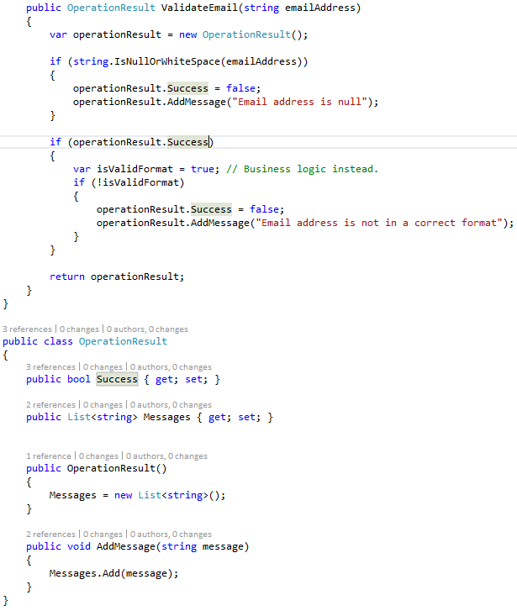
Defensive Coding
More on predictability
Result as
Multiple Values
object
Performing general validation

Slide 20
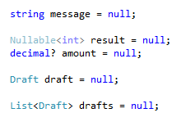
Defensive Coding
More on predictability
Result as Null
Reference not set
Have a convention about collections and be consistent

